Slide 1

Design Patterns in

Slide 2
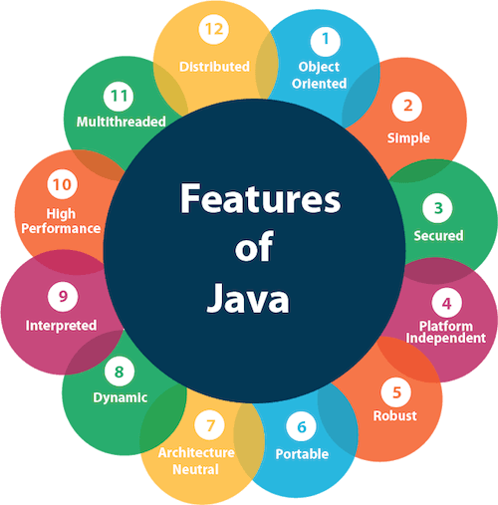
What is Java?

Slide 3

Why Java?

Slide 4
Our problem for today
We are going to replicate a real-life model using OOP in Java.
In the end, we will have a user with some personal data, including a car and a house.
The user, the car and the house will be considered as separate components in the code.

Slide 5
The class structure
User: firstName(mandatory), lastName(mandatory), CNP(mandatory), dateOfBirth(mandatory), nickName, location, car;
Location: address, city(mandatory), country(mandatory), locationType(mandatory), space, year, price;
Car: brand(mandatory), model(mandatory), carType(mandatory), year, seats;
Location Types: house, apartment, duplex;
Car Types: two-seater, regular, van.

Slide 6
Design Patterns
Design patterns are the well-proved solutions for solving specific problems.
Advantages:
Reusable in different projects;
Provide the solutions that help to define the system architecture;
Provide transparency to the design of an application;
Provide clarity to the system architecture and the possibility of building a better system.
Today we’ll focus on 3 design patterns:
builder;
factory;
singleton.

Slide 7
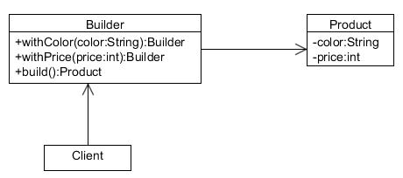
The Builder Pattern
This design pattern allows the creation of complex objects step by step and offers the possibility to reproduce different types and representations of an object using the same construction mode.

Slide 8
Builder Pattern - Advantages
The parameters to the constructor are reduced and are provided in highly readable method calls;
Helps in minimizing the number of parameters in the constructor and thus there is no need to pass in null for optional parameters to the constructor;
Object is always instantiated in a complete state;
Immutable objects can be built without much complex logic in the object building process;
Is thread-safe.

Slide 9
Exercise 1
Convert the Location class to use the Builder pattern. Don’t forget to differentiate the mandatory fields and the optional ones.
Try to create some objects in the main method.

Slide 10
Unit Tests
The unit tests are one of the most important parts in software development for 2 simple reasons: they are showing if your code work as expected and will let you know if your changes impact other components of the project.
We’ll use JUnit 5 in order to test our methods.
To introduce the test framework, we have to add the following dependency in the pom.xml file:
<dependency>
<groupId>org.junit.jupiter</groupId>
<artifactId>junit-jupiter-engine</artifactId>
<version>5.8.1</version>
<scope>test</scope>
</dependency>

Slide 11
Validators & Exceptions
As a developer, you should never focus only on the happy case scenarios. It’s very important to think about all negative scenarios and to identify all corner-case situations (e.g. creation of a user with an invalid CNP).
In order to handle such situations, we should throw an exception so the client will know that something wrong happened during the requested process.
In simple words, an exception is an unwanted event which occurs during the execution of a program and disrupts the normal flow of the instructions.

Slide 12
Types of Exceptions
Checked: the exceptions that are checked at compile time; they cannot be ignored and the developer must take care of them (e.g. FileNotFoundException, IOException).
Unchecked: occurs at the time of execution; they are called Runtime Exceptions; these include programming bugs or logic errors; ignored at compile time (e.g. ArrayIndexOutOfBoundsException, ArithmeticException, the custom exceptions defined by the developer).

Slide 13
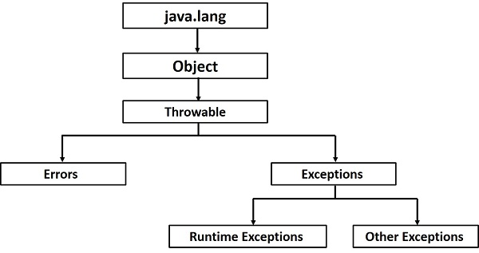
Exception Hierarchy

Slide 14
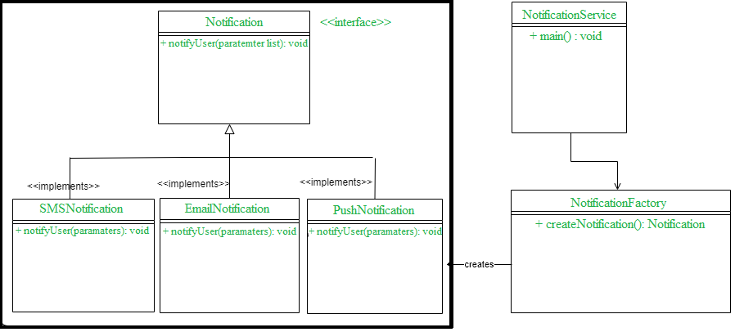
The Factory Pattern
It helps to create objects without exposing the creation logic to the client and refer to the newly created object using a common interface.

Slide 15
Factory Pattern - Advantages
Provides approach to code for interface rather than implementation;
Makes the code more robust, less coupled and easy to extend;
Provides abstraction between implementation and client classes through inheritance.

Slide 16
Exercise 2
Implement the Car’s validator using the factory pattern. Write unit tests for the identified scenarios.
The general validation is that the brand and model fields must have a minimum length of 2.
The TWO-SEATER type must have 2 seats.
The VAN type must have 9 seats.

Slide 17
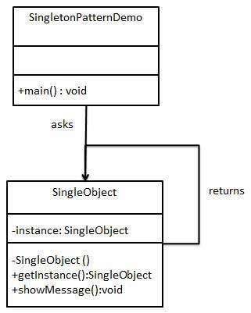
The Singleton Pattern
Involves a single class which is responsible to create an object while making sure that only a single object gets created; provides a way to access its only object without the need to instantiate the object of the class.

Slide 18
Singleton Pattern - Advantages
It saves memory because each request uses the same object;
Increases the performance;
Easy to maintain: it provides only a single point of access to the instance.

Slide 19
Exercise 3
Convert the LocationService and CarService to singleton. Check the address and see if the change is effective.

